Slide 1
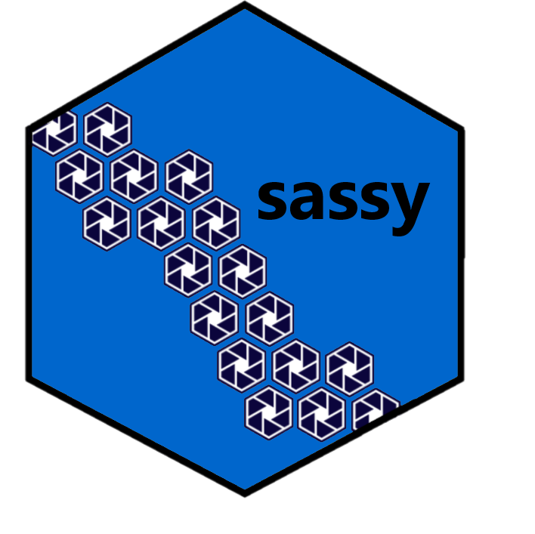
Introduction to R
Lists

Slide 2
Key Points
A list is a set of R objects of any type
Lists are very flexible structures
Can access list items with dollar syntax
Lists are often used as output of functions

Slide 3
Suggested Exercises
Create some lists
Practice subsetting
Practice assigning and deleting list items

Slide 4
Introduction to R
Lists

